Slide 1

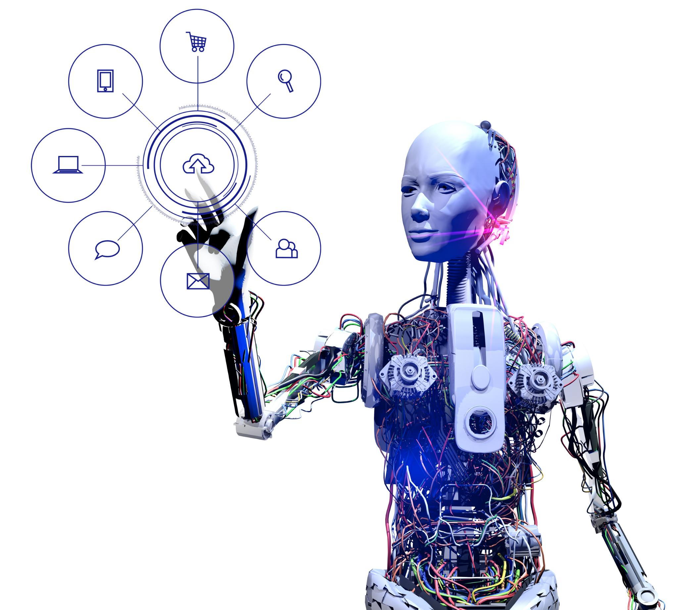
A Review of Current AI Chatbot Testing Frameworks
By: Meshaal Al-Saffar
(200607511)
Dr. Abdelkarim Erradi
CMPT 782 – Special Topics in Computer Science
(Web Development)

Slide 2
Agenda
Introduction
Survey Scope
Existing Tools
Testing Methods Taxonomies
Comparisons Dimensions
Gaps in Existing Frameworks
Proposed Solution
AI Chatbots meet Web Dev.

Slide 3

Introduction
AI chatbots are used in critical domains
like healthcare, education, and climate communication
Human fact-checking is slow and expensive;
fully automated methods lack reliability
There is a need to focus on truthfulness and fact-checking
Review & proposal of FactBridgeAI: a semi-automated, human-in-the-loop framework for truth evaluation
Yet many generate hallucinations,
plausible but factually incorrect answers

Slide 4
AI Chatbots meets Web Development
Chatbots are now a first-class web component
Content integrity = front-end quality
Security & compliance angle
Database & API integration
User-experience continuity
Future-proofing
Parallels with existing Web-Dev testing
Performance optimization

Slide 5
Survey Scope
9
peer-reviewed tools
5
testing methods taxonomy
8
comparison dimensions

Slide 6
Existing Tools
TruthfulQA
ChatEval
MutaBot
FACT-GPT
ChatClimate
BoTest
DialTest
Bottester
OggyBug

Slide 7
[1] S. Lin, J. Hilton, and O. Evans, “TruthfulQA: Measuring How Models Mimic Human Falsehoods,” in Proceedings of the 60th Annual Meeting of the Association for Computational Linguistics (Volume 1: Long Papers), S. Muresan, P. Nakov, and A. Villavicencio, Eds., Dublin, Ireland: Association for Computational Linguistics, May 2022, pp. 3214–3252. doi: 10.18653/v1/2022.acl-long.229.
[2] J. Sedoc, D. Ippolito, A. Kirubarajan, J. Thirani, L. Ungar, and C. Callison-Burch, “ChatEval: A Tool for Chatbot Evaluation,” in Proceedings of the 2019 Conference of the North, Minneapolis, Minnesota: Association for Computational Linguistics, 2019, pp. 60–65. doi: 10.18653/v1/N19-4011.
[3] M. F. Urrico, D. Clerissi, and L. Mariani, “MutaBot: A Mutation Testing Approach for Chatbots,” in Proceedings of the 2024 IEEE/ACM 46th International Conference on Software Engineering: Companion Proceedings, in ICSE-Companion ’24. New York, NY, USA: Association for Computing Machinery, May 2024, pp. 79–83. doi: 10.1145/3639478.3640032.
[4] E. C. Choi and E. Ferrara, “FACT-GPT: Fact-Checking Augmentation via Claim Matching with LLMs,” in Companion Proceedings of the ACM Web Conference 2024, Singapore Singapore: ACM, May 2024, pp. 883–886. doi: 10.1145/3589335.3651504.
[5] S. A. Vaghefi et al., “ChatClimate: Grounding conversational AI in climate science,” Commun Earth Environ, vol. 4, no. 1, p. 480, Dec. 2023, doi: 10.1038/s43247-023-01084-x.
[6] E. Ruane, T. Faure, R. Smith, D. Bean, J. Carson-Berndsen, and A. Ventresque, “BoTest: a Framework to Test the Quality of Conversational Agents Using Divergent Input Examples,” in Companion Proceedings of the 23rd International Conference on Intelligent User Interfaces, in IUI ’18 Companion. New York, NY, USA: Association for Computing Machinery, Mar. 2018, pp. 1–2. doi: 10.1145/3180308.3180373.
[7] Z. Liu, Y. Feng, and Z. Chen, “DialTest: automated testing for recurrent-neural-network-driven dialogue systems,” in Proceedings of the 30th ACM SIGSOFT International Symposium on Software Testing and Analysis, Virtual Denmark: ACM, Jul. 2021, pp. 115–126. doi: 10.1145/3460319.3464829.
[8] M. Vasconcelos, H. Candello, C. Pinhanez, and T. dos Santos, “Bottester: Testing Conversational Systems with Simulated Users,” in Proceedings of the XVI Brazilian Symposium on Human Factors in Computing Systems, in IHC ’17. New York, NY, USA: Association for Computing Machinery, Oct. 2017, pp. 1–4. doi: 10.1145/3160504.3160584.
[9] M. B. D. Santos, A. P. C. C. Furtado, S. C. Nogueira, and D. D. Moreira, “OggyBug: A Test Automation Tool in Chatbots,” in Proceedings of the 5th Brazilian Symposium on Systematic and Automated Software Testing, Natal Brazil: ACM, Oct. 2020, pp. 79–87. doi: 10.1145/3425174.3425230.

Slide 8
Testing Methods Taxonomies
Usability testing: Real or alternate users interact with the bot. Evaluators judge clarity, coherence and satisfaction.
Simulated-user testing: Pre-scripted prompts are replayed automatically, and outputs are compared with expected answers.
AI-planning testing: Dialogue states are modelled as a planning problem. Test sequences are generated to hit rarely visited branches.
Metamorphic testing: The bot or its input is systematically mutated while expected logical relations hold constant.
Paraphrase testing: Semantically equivalent utterances (spelling errors, syntax changes) probe robustness without altering intent.
Lin et al. [10] group chatbot testing methodologies into five families:
[10] X. Li, C. Tao, J. Gao, and H. Guo, “A Review of Quality Assurance Research of Dialogue Systems,” in 2022 IEEE International Conference On Artificial Intelligence Testing (AITest), Aug. 2022, pp. 87–94. doi: 10.1109/AITest55621.2022.00021.

Slide 9
Comparison Dimensions
🧠 1. Knowledge Base
🧪 2. Evaluation Method Approach
✍️ 5. Score Ownership
🧩 6. Backend Code Architecture
👤 3. Human Involvement Timing
📊 4. Truth Scoring Scale
🎨 7. Frontend Code Architecture
🧪 8. Testing Methodology

Slide 10
Tool | Knowledge Base | Eval Method | Human Involvement | Scoring Scale | Score Owner | Backend | Frontend | Testing Methodology
TruthfulQA | QA corpus with sources | Human + LLM | Write questions, craft gold answers, rate system outputs | Graded (0–1) | Human + LLM | Python | CLI | Simulated-users
ChatEval | User logs | Crowd + metrics | Crowd workers rate coherence, etc. | Likert scale | Crowd | Python | Web UI | Usability, Simulated-users
FACT-GPT | Claim DB + LLM | LLM scoring + human | Experts curate seed claims and validate matches | Binary + LLM match | LLM + Human Audit | Python | Notebook / REST demo, no full GUI | Simulated Users
ChatClimate | Climate-science corpus | Expert scoring | Scientists design rubric and score 170 test statements | 4-level credibility scale | Experts | Python | CLI | Simulated Users
MutaBot | Mutants of training set and code | Mutation rules | Inspect surviving mutants if needed | Binary pass/fail | Script logic | Python | CLI | Metamorphic, Simulated-users
BoTest | Utterances for a small-talk bot | Mutant input detection | Authors craft divergents and tally results | Binary pass/fail | Script logic | Python | CLI | Paraphrase, Simulated-users
DialTest | RNN dialogue model’s seed utterances | Coverage metrics | Humans design operators & inspect failures | Numeric + coverage | Script logic | Python | CLI | Metamorphic, Simulated-users
Bottester | Scripted dialogues | Simulated chat, logs correctness, latency, repetitions | Authors prepare scenarios; optional manual review | Binary | Script logic | Python | Desktop dashboard | Simulated-users, Metamorphic, Paraphrase
OggyBug | JSON test scenarios | Assertion replay | Staff write scenarios and set assertions | Binary | Script logic | Python | Web UI | Simulated-users, Metamorphic

Slide 11
Gaps in Existing Frameworks
❌ Human Review Misallocation
No filters targeting low-confidence outputs for targeted human review.
🧾 Limited Traceability
Limited centralized persistent log for prompts, scores, model outputs, or human feedback.
ChatClimate and TruthfulQA use humans for all answers, not just uncertain ones.
Bottester and OggyBug log data locally (SQLite, JSON)
🔁 Limited Scalability
ChatEval and MutaBot use Docker/GitLab-CI
Other tools rely on manual Python setups.
Confidence-based escalation to humans
Persistent queryable test repository
Container-based scalability

Slide 12
How the proposed solution, FactBridgeAI, solves these issues?
✅ Confidence-Driven Human Review
Only low-confidence results are flagged for expert check, reducing wasted effort.
🗂️ Full Test Traceability
Central relational database logs prompts, answers and scores.
Enables tracking chatbot performance across time and versions.
🐳 Scalable Docker Stack
Uses Docker Compose to run chatbot, scorer, and UI as services.
Test runs can be exactly replayed anytime, solving drift issues.
🎯 Inspired by Best Practices
Combines the simulated-user loop with GPT-based scoring.
Web UI lets experts review only when needed

Slide 13
Tool | Knowledge Base | Eval Method | Human Involvement | Scoring Scale | Score Owner | Backend | Frontend | Testing Methodology
TruthfulQA | QA corpus with sources | Human + LLM | Write questions, craft gold answers, rate system outputs | Graded (0–1) | Human + LLM | Python | CLI | Simulated-users
ChatEval | User logs | Crowd + metrics | Crowd workers rate coherence, etc. | Likert scale | Crowd | Python | Web UI | Usability, Simulated-users
FACT-GPT | Claim DB + LLM | LLM scoring + human | Experts curate seed claims and validate matches | Binary + LLM match | LLM + Human Audit | Python | Notebook / REST demo, no full GUI | Simulated Users
ChatClimate | Climate-science corpus | Expert scoring | Scientists design rubric and score 170 test statements | 4-level credibility scale | Experts | Python | CLI | Simulated Users
MutaBot | Mutants of training set and code | Mutation rules | Inspect surviving mutants if needed | Binary pass/fail | Script logic | Python | CLI | Metamorphic, Simulated-users
BoTest | Utterances for a small-talk bot | Mutant input detection | Authors craft divergents and tally results | Binary pass/fail | Script logic | Python | CLI | Paraphrase, Simulated-users
DialTest | RNN dialogue model’s seed utterances | Coverage metrics | Humans design operators & inspect failures | Numeric + coverage | Script logic | Python | CLI | Metamorphic, Simulated-users
Bottester | Scripted dialogues | Simulated chat, logs correctness, latency, repetitions | Authors prepare scenarios; optional manual review | Binary | Script logic | Python | Desktop dashboard | Simulated-users, Metamorphic, Paraphrase
OggyBug | JSON test scenarios | Assertion replay | Staff write scenarios and set assertions | Binary | Script logic | Python | Web UI | Simulated-users, Metamorphic
FactBridgeAI | User test cases | LLM scoring + filter | Only low-confidence | Graded + confidence level | LLM + Human-in-loop | Next.js + Docker | Web UI | All except AI Planning (supports 4 of 5 types)

Slide 14
Conclusions
Through the analysis of existing tools, we point out a gap in ensuring the truthfulness and reliability of AI chatbot interactions within modern web applications.
Through the design of a semi-automated human-in-the-loop framework (FactBridgeAI), we aim to contribute to more trustworthy, testable, and web-integrated conversational systems.

Slide 15
Thank you

